Slide 1
Enterprise CI-CD testing done right
Jan-Hendrik Peters, Premier Field Engineer (Microsoft Germany GmbH)

Slide 2
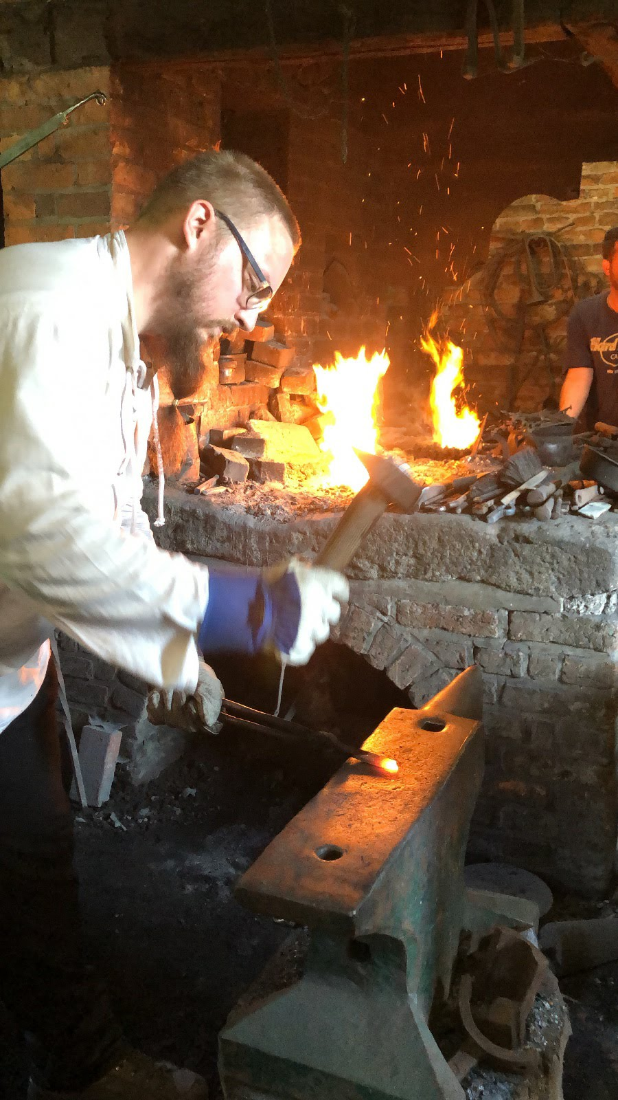


whoami
Premier Field Engineer at Microsoft Germany
Automating things since 2011
Azure, DevOps, PowerShell, C#
Developer at OSS project AutomatedLab
nyanhp
nyanhp

Slide 3


A typical pipeline - Source
Commit
public static void main (string[] args)
Notes:
Your typical build and release pipeline might look a bit like this
Starting with the commit or the Pull Request of a developer
The same process is of course also viable for operators designing IaC code

Slide 4


A typical pipeline – Unit tests
Commit
Test
public static void main (string[] args)
Notes:
A host of unit tests will be executed and the results published to the tool
This can also apply to IaC, e.g. in order to test your code-generating code

Slide 5

A typical pipeline - Build
Commit
Test
Build
public static void main (string[] args)
Notes:
After the initial validation phase, the pipeline artifacts are built and published to the pipeline or an artifact store
These artifacts can be anything from IaC templates to PowerShell Modules and applications

Slide 6

A typical pipeline - UAT
Commit
Test
Build
Test
public static void main (string[] args)
Notes:
After the artifacts are available, another test phase, the user acceptance test, may run.
Often in my case, these would be integration tests of PowerShell DSC configurations being applied to a range of test systems
For our intents and purposes, this will mean deploying and integration testing a web application

Slide 7

A typical pipeline - Release
Commit
Test
Build
Test
Release
public static void main (string[] args)
Notes:
Finally, after all tests have been completed and possible release gates have been passed, approvals have occurred , a release is deployed
This again might mean deploying a module to the PowerShell gallery, libraries to NuGet, Docker images to an image registry, or –in our case – a web app to an Azure App Service (or an on-premises web server)

Slide 8
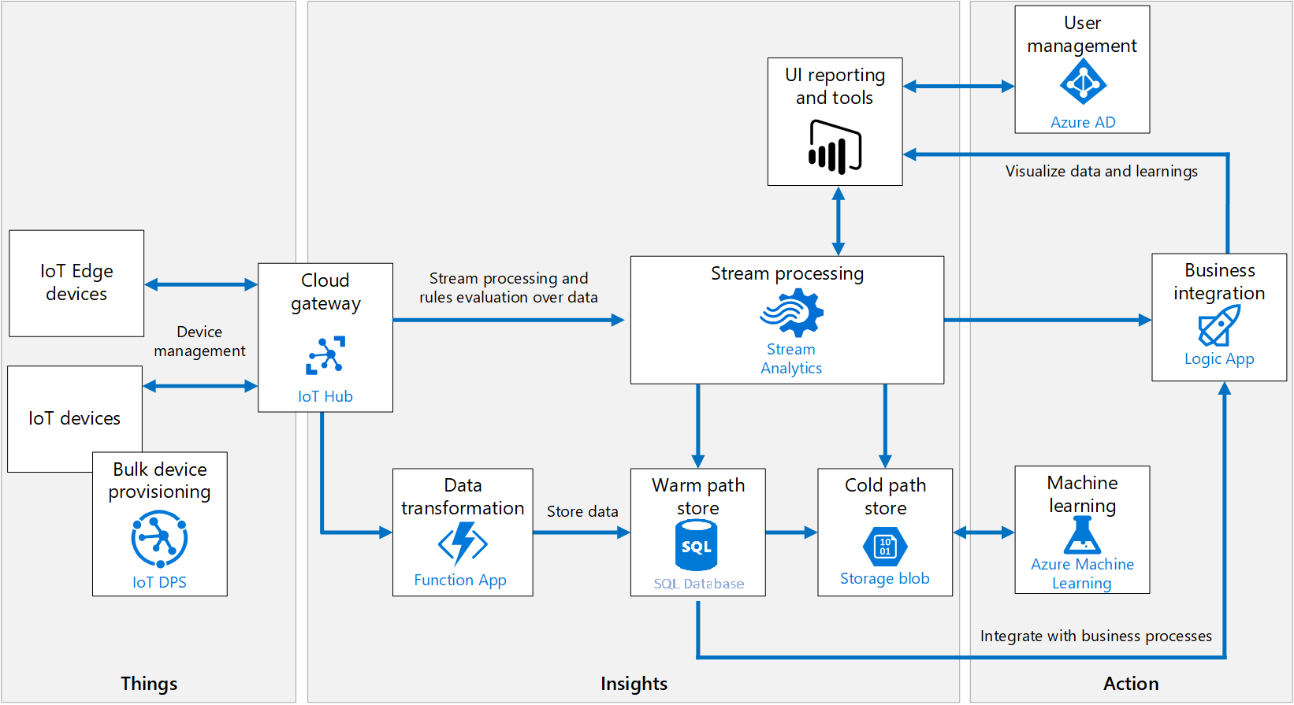
Testing
Integration testing requires appropriate environment
Notes:
In this presentation, I would like to get into more detail, how testing in a living, breathing environment might look like
Integration tests often require an environment that closely mirrors the production environment

Slide 9
Testing
Integration testing requires appropriate environment
Often additional components are necessary
Certificates
Databases
Web servers
Notes:
Very often, additional components are required to closely mimic the production environment
Maybe an Active Directory domain is necessary to test authentication.
More than likely a database is needed which includes some sample data
To deploy a web app, a pre-configured web server would be nice
In order to properly test web apps, certificates need to be enrolled for as well

Slide 10
Testing
Integration testing requires appropriate environment
Often additional components are necessary
Certificates
Databases
Web servers
Some tooling can already help
Docker
Packer
Selenium
Notes:
There is some tooling available to help in some cases, but in order to create a proper testing environment that can be recreated at a whim, none of these tools are a great fit

Slide 11
Testing
Integration testing requires appropriate environment
Often additional components are necessary
Certificates
Databases
Web servers
Some tooling can already help
Docker
Packer
Selenium
Notes:
In the next minutes, I would like to get into testing with additional components

Slide 12


Testing with AutomatedLab
Photo by Franck V. on Unsplash
Notes:
Photo by Franck V. on Unsplash

Slide 13
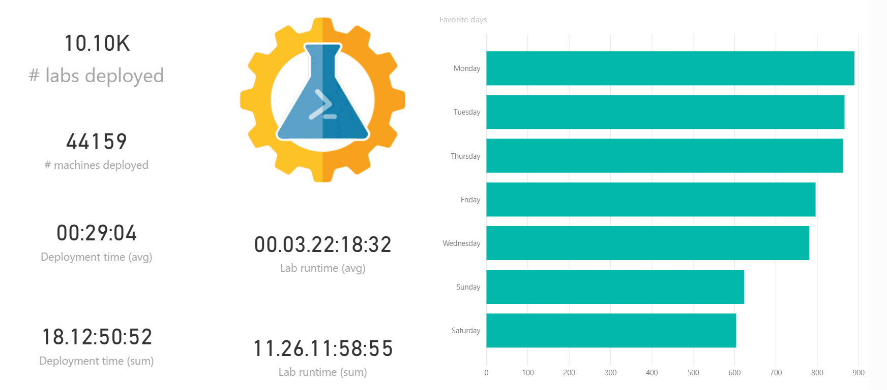

Intro - AutomatedLab
Open-source lab automation framework
Notes:
AutomatedLab is an open source lab framework, capable of deploying typical workloads

Slide 14
Intro - AutomatedLab
Open-source lab automation framework
Infrastructure as code
LabRecipe MySuperLab {
DeployRole = 'Domain', 'SQL'
VmPrefix = 'LB'
} | Invoke-LabRecipe
Notes:
We follow the Infrastructure as Code model, where your deployments are idempotent

Slide 15
Intro - AutomatedLab
Open-source lab automation framework
Infrastructure as code
Deploy idempotent environments to your specifications anywhere
Notes:
We follow the Infrastructure as Code model, where your deployments are idempotent

Slide 16
Intro - AutomatedLab
Open-source lab automation framework
Infrastructure as code
Deploy idempotent environments to your specifications anywhere
Runs with PowerShell on Windows and Linux
Notes:
It runs on PowerShell, which works on many platforms. We tested AutomatedLab on Ubuntu and CentOS

Slide 17
Intro - AutomatedLab
Open-source lab automation framework
Infrastructure as code
Deploy idempotent environments to your specifications anywhere
Runs with PowerShell on Windows and Linux
Deploys to Hyper-V and Azure
In active development: kvm/quemu support on Linux
Notes:
We currently deploy to Hyper-V and Azure, and I am working on kvm/quemu
We would love to see your contributions as well, if you e.g. want to port this to AWS or other cloud providers, or other platforms like VMWare

Slide 18
Intro - AutomatedLab
Open-source lab automation framework
Infrastructure as code
Deploy idempotent environments to your specifications anywhere
Runs with PowerShell on Windows and Linux
Deploys to Hyper-V and Azure
In active development: kvm/quemu support on Linux
Deploys Windows and Linux VMs, Azure App Services

Slide 19
Intro - AutomatedLab
Zero-touch deployment of many roles, including (but not limited to)
ADDS
ADCS
ADFS
SQL Server 2008 – vNext
TFS/Azure DevOps Server
DHCP
DSC
Failover Cluster
Nested Virtualization
NuGet
SharePoint
Office Server

Slide 20
A „simple“ environment
New-LabDefinition -Name SimpleYetEffective
Add-LabIsoImageDefinition -Name SQLServer2019 -Path $labsources\ISOs\sql_server_2019.iso
Add-LabMachineDefinition -Name DC -Roles RootDc,CARoot
Add-LabMachineDefinition -Name SQL -Roles SQLServer2019
Add-LabMachineDefinition -Name WEB -Roles WebServer
Install-Lab
Notes:
This is a complex environment, if you think about it. With a total of 5 lines of code, every component necessary to test your software is deployed –every time.
The RootDc role deploys an entire Active Directory forest and can be combined with provisioning of identities and roles
The CARoot role deploys an enterprise root CA and can be used to allow the web server to enroll for an SSL certificate
The SQLServer role deploys a SQL instance including reporting as well as the Microsoft sample database, and can be customized as well
The WebServer role configures a standard IIS web server with all necessary features to test

Slide 21

AutomatedLab in pipelines
Seamlessly integrate into validation
Notes:
AutomatedLab can seamlessly be integrated in your validation steps
It can run on nearly any build worker running Windows or Linux
Ideally, you would use a private agent on a Hyper-V host or on Azure Stack
Connecting to existing infra is also possible, lab resources will be cleaned up and existing resources remain untouched

Slide 22

AutomatedLab in pipelines
Seamlessly integrate into validation
Runs on Linux and Windows build workers
PowerShell Gallery download recommended
Pre-built msi,deb and rpm packages
Notes:
AutomatedLab can seamlessly be integrated in your validation steps
It can run on nearly any build worker running Windows or Linux
Ideally, you would use a private agent on a Hyper-V host or on Azure Stack
Connecting to existing infra is also possible, lab resources will be cleaned up and existing resources remain untouched

Slide 23

AutomatedLab in pipelines
Seamlessly integrate into validation
Runs on Linux and Windows build workers
Ideally suited for self-hosted workers running Hyper-V
PowerShell Gallery download recommended
Pre-built msi,deb and rpm packages
Notes:
AutomatedLab can seamlessly be integrated in your validation steps
It can run on nearly any build worker running Windows or Linux
Ideally, you would use a private agent on a Hyper-V host or on Azure Stack
Connecting to existing infra is also possible, lab resources will be cleaned up and existing resources remain untouched

Slide 24
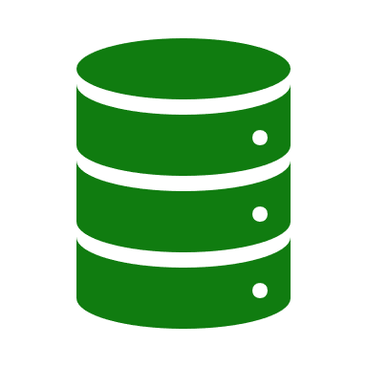
AutomatedLab in pipelines
Seamlessly integrate into validation
Runs on Linux and Windows build workers
Ideally suited for self-hosted workers running Hyper-V
Multiple modes
PowerShell Gallery download recommended
Pre-built msi,deb and rpm packages
Fresh deployment
Reuse existing lab
Connect to existing infrastructure (e.g. Active Directory domain)
Notes:
AutomatedLab can seamlessly be integrated in your validation steps
It can run on nearly any build worker running Windows or Linux
Ideally, you would use a private agent on a Hyper-V host or on Azure Stack
Connecting to existing infra is also possible, lab resources will be cleaned up and existing resources remain untouched

Slide 25
Demo: Pipeline for DSC configs

Slide 26
Summary
AutomatedLab helps with complex test environments
AutomatedLab deploys repeatable environments end to end
Help will be given to those that ask for it: https://automatedlab.org
Issues and PRs go to https://github.com/automatedlab/automatedlab

